Slide 1
Phrasal verbs

Slide 2


Slide 3
to break –
to bring –
ломать
приносить

Slide 4
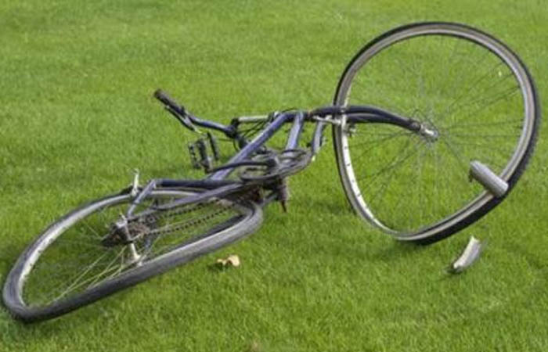
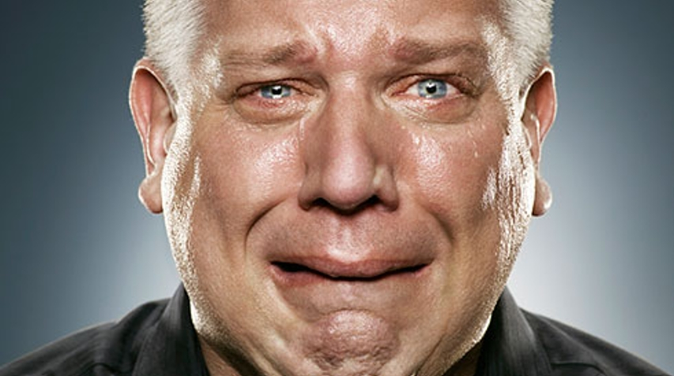
Break down :
stop working
lose control of feelings
( ломать(ся) )
(потерять самообладание)

Slide 5
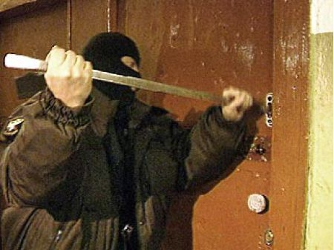
Break in :
enter by force
+ break into (a building)
( взламывать, вторгаться )

Slide 6


Break out :
begin suddenly (storm, war)
escape
( разразиться, внезапно начаться )
( сбежать )

Slide 7

Break off :
break a piece from something
( отламывать (кусок))

Slide 8

Bring about :
1) cause to happen
( вызывать что-либо)

Slide 9
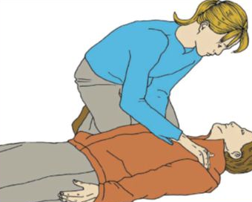

Bring sb (a)round :
regain consciousness
2) persuade
( приводить кого-либо в чувство )
( убеждать кого-либо )

Slide 10

Bring up :
1) raise a child
( воспитывать )

Slide 11
Choose the correct preposition
The machines at the factory where Dan works often break down/up
2) Michael’s grandparents brought him up/about on a farm
3) Ann broke out/down and started crying when she heard she didn’t get the job
4) The nurse brought him about/round gently after the operation
5) The police are still looking for the prisoner who broke down/out of prison yesterday
6) When Sally dropped her cup , the handle broke up/off
7) Thieves broke into/out our house while we were at the cinema

